Slide 1
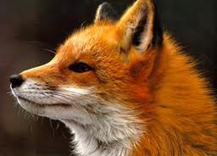
Armies Of Animalia

Slide 2
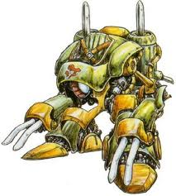
OUR GAME
Side-scrolling 2-D platform with a 2.5-D feel
Takes place in a parallel universe combining magic and technology—magitek.

Slide 3

OBJECTIVE
To stop an enemy army that is invading the kingdom
Run through levels fighting off minions
Collect power-ups to improve chances of survival
To defeat the General at the end of each level

Slide 4
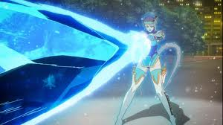
ABILITIES
Sword
Jumps
Magic -
fireball
wind gust
ice blast
*revise as needed

Slide 5
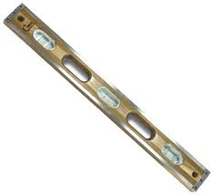
LEVELS
Forest
City
Mountain
Ocean
Desert
Moon
Castle
*revise as needed

Slide 6
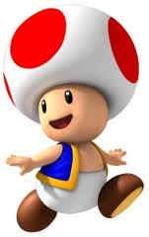
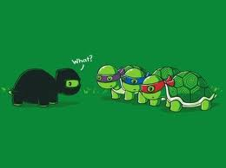
ENEMIES
Squids
Elephants
Wolves
Mushroom people
“Ninja” turtles
Moon men
*revise as needed

Slide 7

COLLECTABLES/REWARDS
Collectables -
Gems
Magic “mana” potions
Health potions
1-ups.
Rewards -
Health-ups
Magic-ups.
*revise as needed

Slide 8
PROGRAMMING TECHNIQUES
A pragmatic programming approach in the beginning to have an early alpha game
Use pixel collision to collect rewards as well as fighting enemies
Use sprite sheets for animations of the player, minions, generals, and power-ups
Integrate parallax effects to simulate a 2.5-D feel
Use C# and the XNA framework
Use Adobe Sound Booth for sounds, Adobe Photoshop and Flash for the art, and Adobe Illustrator for the vector art

Slide 9
PROJECT CAREERS
Joe Goudreau - Artist and AI Developer
Kyle Groom - Game Designer and Sound Engineer
Peter Piper - Software Architect and Product Manager

Slide 10
RESPONSIBILITIES
Make rough sketches of the game world - Joe
Render game world details - Joe
Design player and/or creature graphics - Joe
Create audio - Kyle
Identify player/creature actions and responses - Joe
Design level data file format - Kyle
Create level data content - Joe
Software modules for …
User interaction - Kyle
Game mechanics - Peter
Game configuration - Peter
Score keeping and display – Kyle

